Slide 1


Align Strategy | Drive Execution | Engage People

Reporting Capabilities
→
VP Sales
Randy Clark
Randy.Clark@kpifire.com
801 456-8172

Slide 2
Report Types
Project Reports
Metric Reports
Goal Reports
User Reports
List View
Tile View
Accountability Report
Benefits Report
Budget Report
Budget Exception Report
Summary Report
Portfolio Timeline Report
Summary Table Report
Team Engagement Report
Work Time By Team Member Report
Work Time By Project Report
List View
Tile View
Tree View
Bowling View
Summary Report
List View
Tile View
Bowling View
Grid View
X-Matrix View
User Certification List View
Huddleboards
Build your Own Custom Dashboards
Balanced Scorecard
Custom X-Matrix
Idea Reports
Idea Funnel / Prioritization
Team Engagement Report
All Reports and Views can be Filtered by User, Goal, Department, Year, and Category.
Filtered Views can be Saved For Easy Access.
Reports can be Exported to CSV / Excel or via API to be used by Third-Party Reporting tools such as PowerBI.

Slide 3
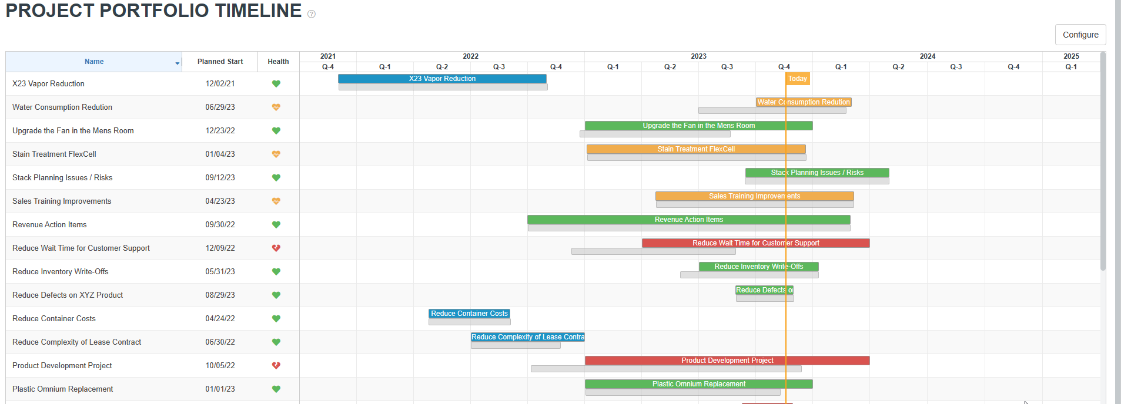
Project Reports
List View
Tile View
Accountability Report
Benefits Report
Budget Report
Budget Exception Report
Summary Report
Portfolio Timeline Report
Summary Table Report
Team Engagement Report
Work Time By Team Member Report
Work Time By Project Report

Slide 4
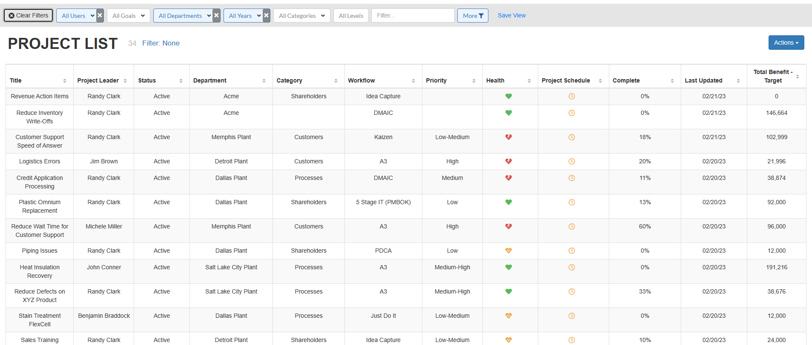
Project List View

Slide 5
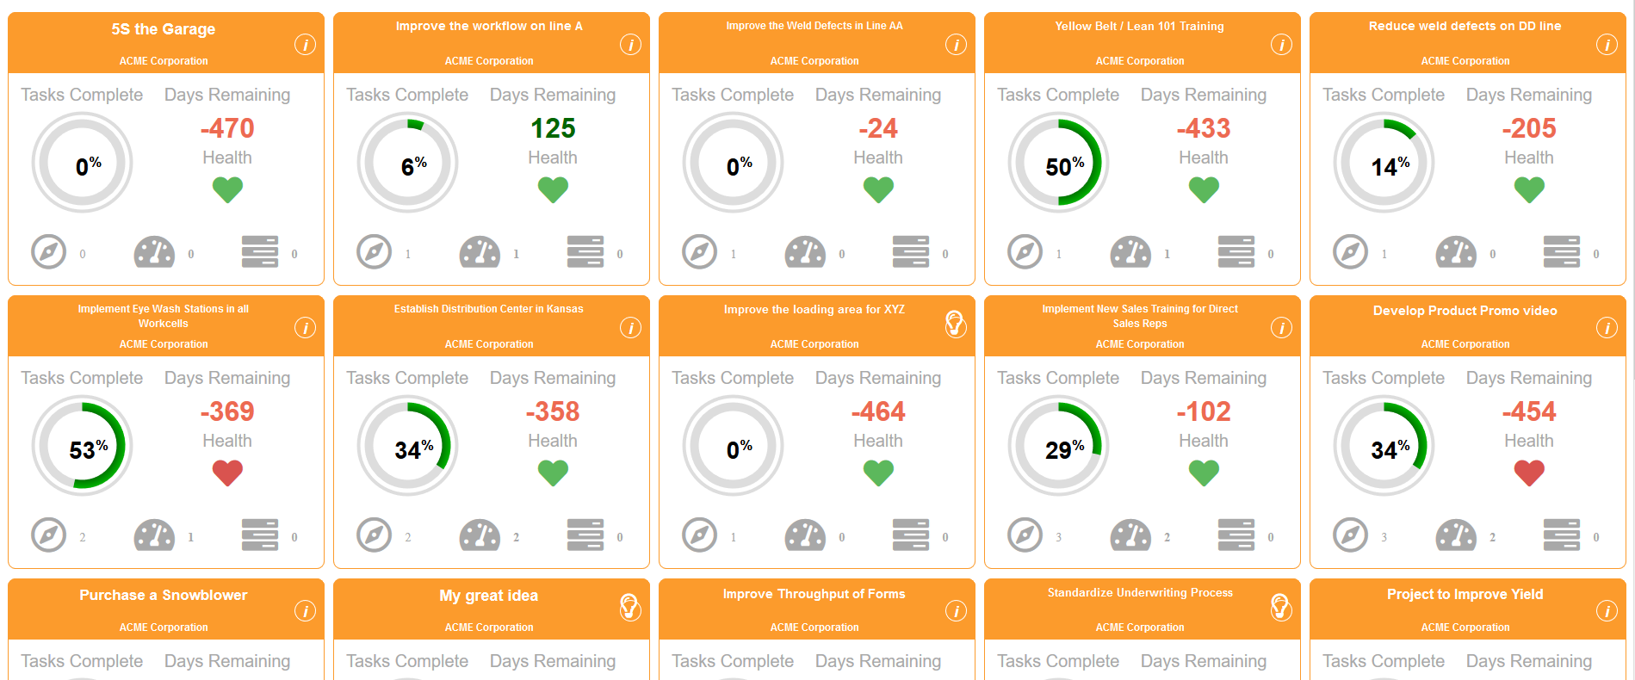
Project Tile View
Each Project Tile Displays:
% of Planned Tasks Completed
Days Remaining
Health
Linkage to Goals, Metrics, or other Projects

Slide 6
Project Accountability Report
Tracking Major Project Milestones around:
Charter Status
Team Status
Financial Benefits Status

Slide 7
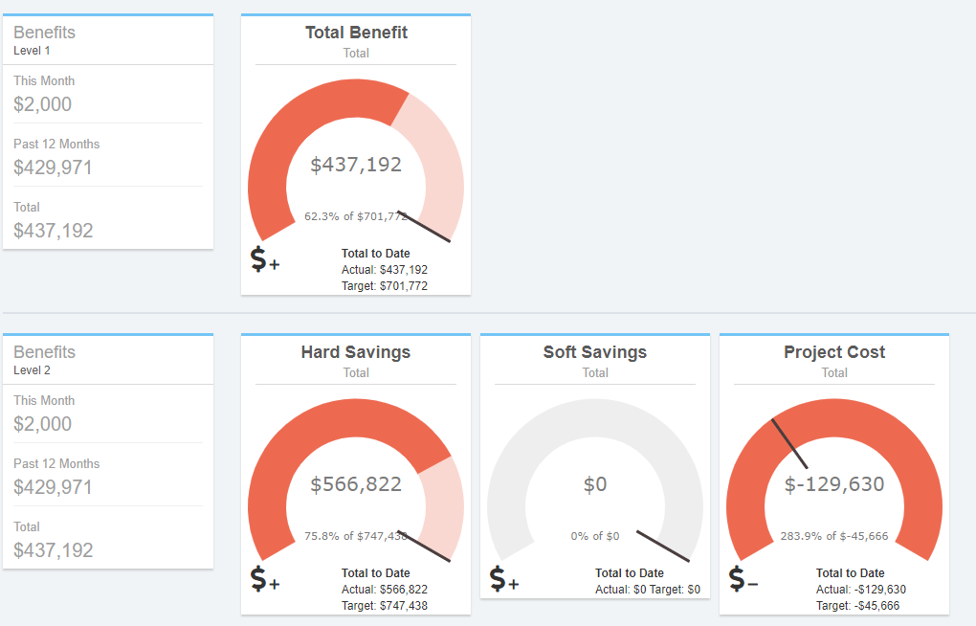
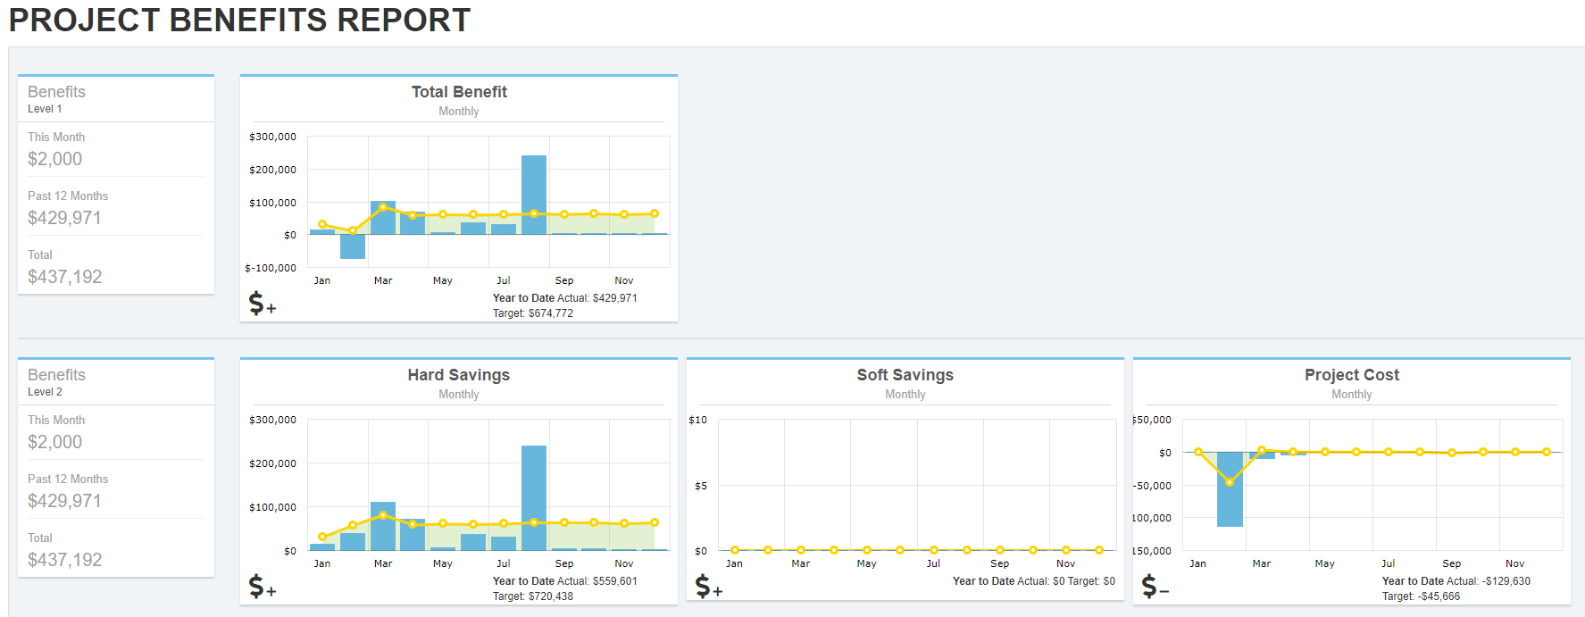
Project Benefits Report
Roll Up Project Benefits
Visualize Actual vs Target
Display Total, Monthly, Quarterly

Slide 8
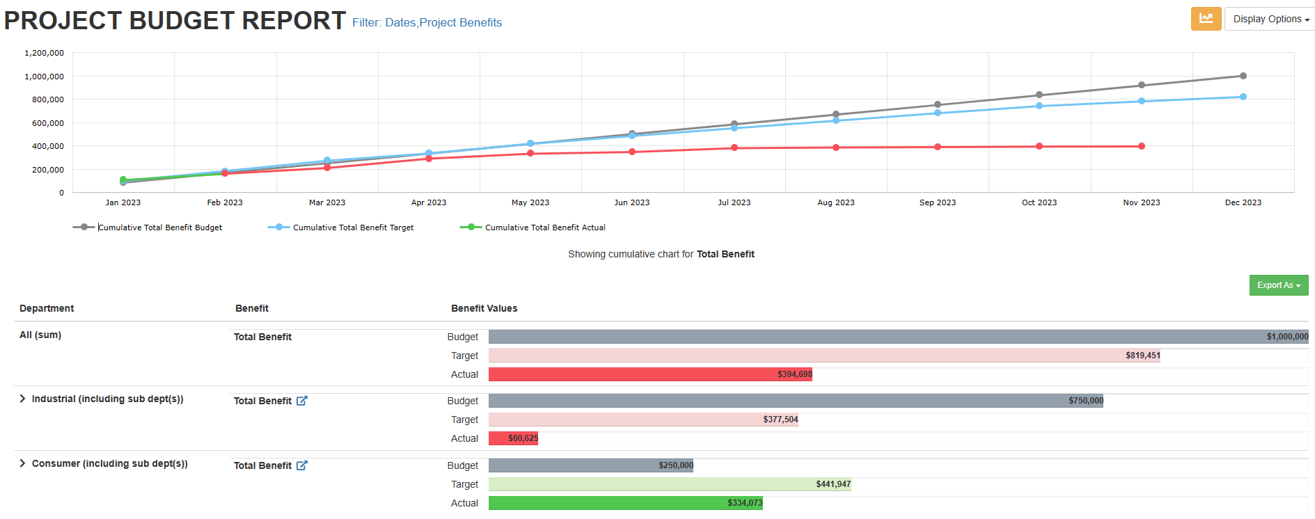
Project Budget Report
Roll Up Project Benefits vs Budgeted Target
Visualize Actual vs Target
Display Accumulative Trend
Drill Down by Department / Unit

Slide 9
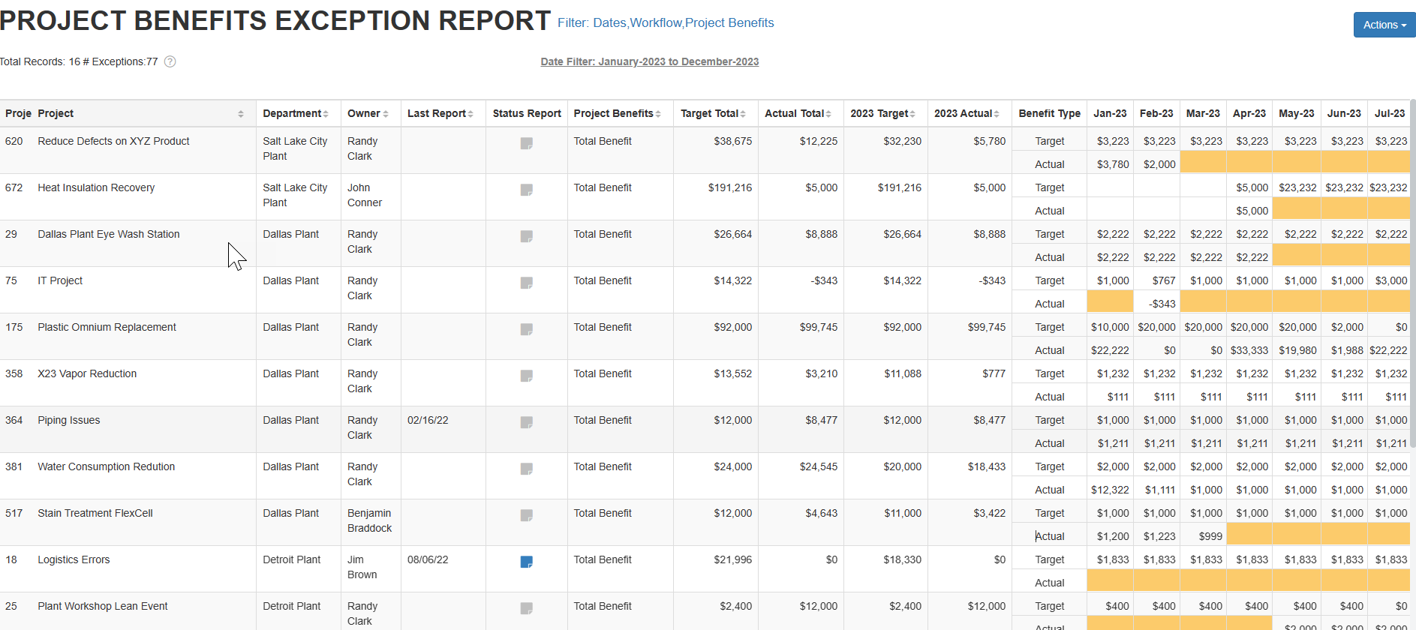
Project Benefits Exception Report
Highlight projects that have a Savings Target, but have no Actual Savings entered.

Slide 10
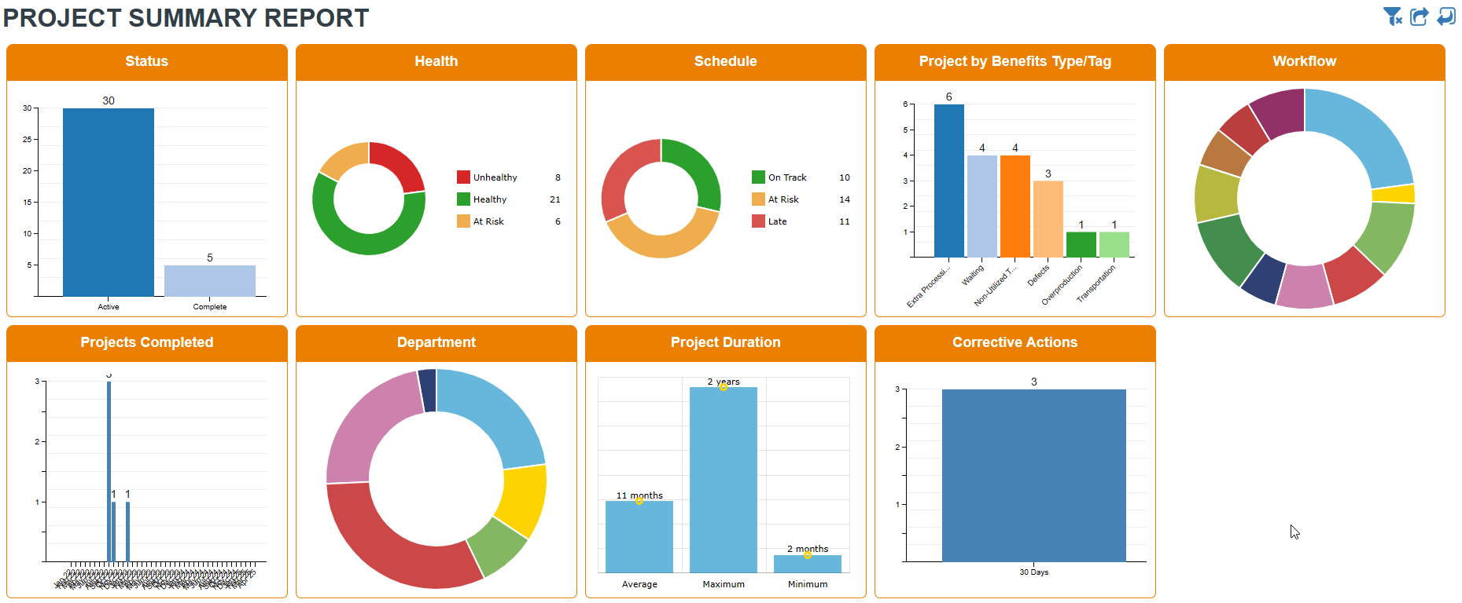
Project Summary Report
Summarize Project Activity:
Status / Health / Schedule / Type / Workflow / Department.
View Max, Min and Avg Project Duration

Slide 11
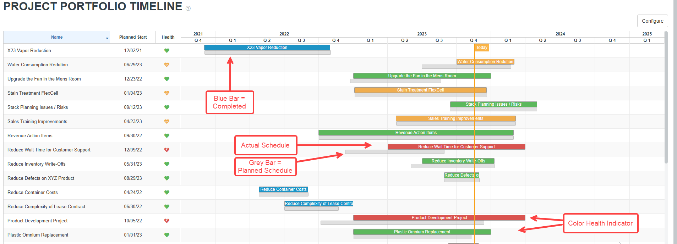
Project Portfolio Timeline Report

Slide 12
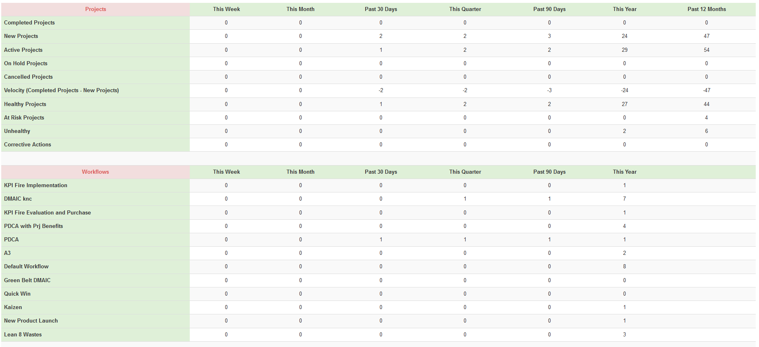
Project Summary Table Report
Summarize Activity From This Week to the Past 12 Months
# Projects Completed
# New Projects Created
Total # Active Projects
# On Hold or Cancelled
Velocity
# Healthy / At Risk Projects / Unhealthy

Slide 13
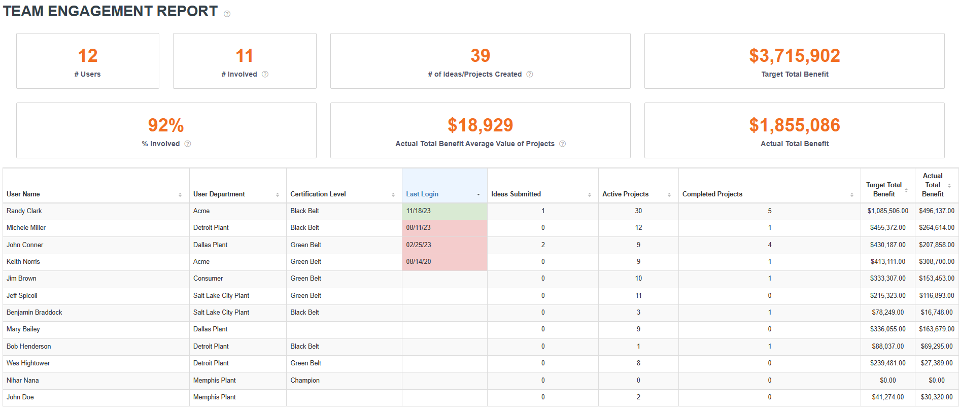
Team Engagement Report
Team Engagement
What % of Total Users are Involved
Have Submitted an Idea or are on a Project
Who is Submitting Ideas
Last Login per User
Total Value of Projects Users are Involved in Delivering

Slide 14
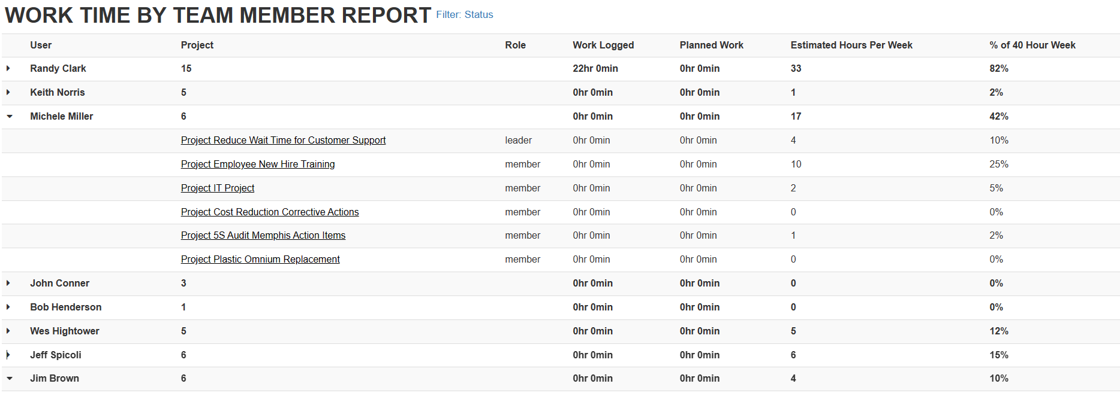
Work Time By Team Member Report
Allocate Resources
Who is Available for More Work
Who is Over Allocated
On What Projects are they Spending their Time

Slide 15
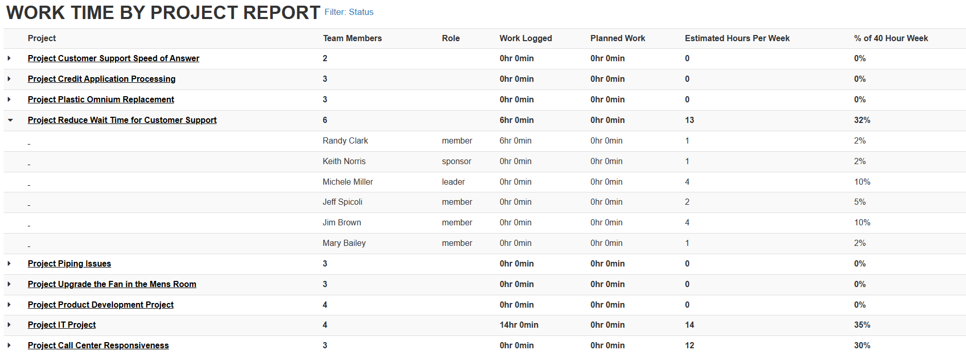
Work Time by Project Report

Slide 16
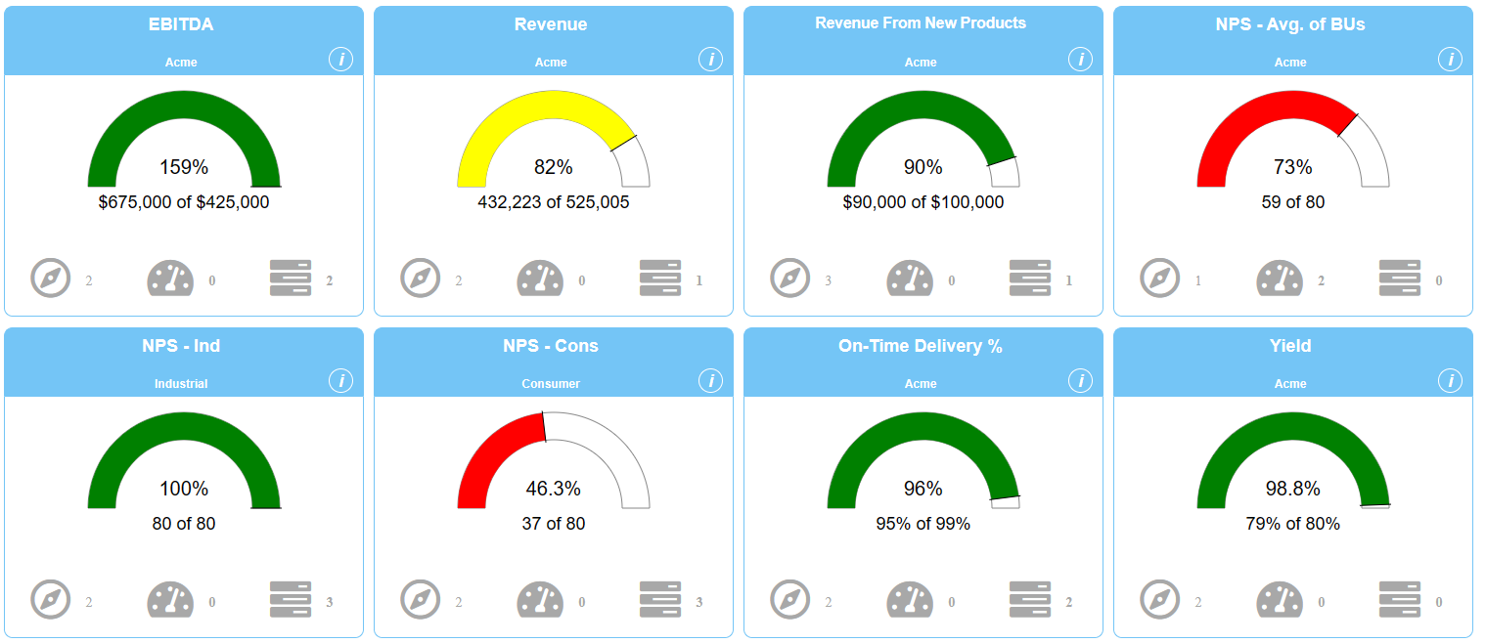
Metric Reports
List View
Tile View
Tree View
Bowling View
Summary Report

Slide 17
Metric List View

Slide 18
Metric Tile View
Metric Tiles Include
Health RYG Status Based on your Tolerances
% of Target Achieved
Linkage to Goals, Metrics, and Projects

Slide 19
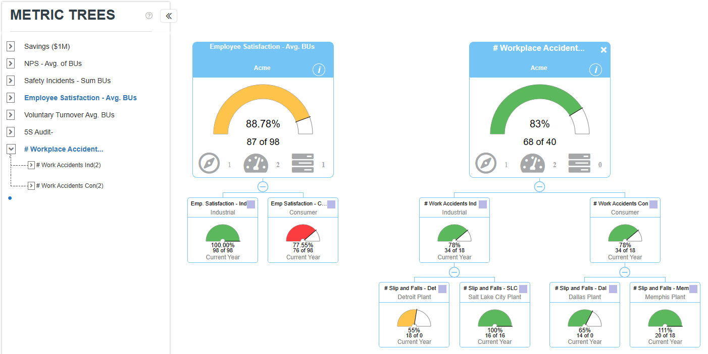
Metric Tree View
Visualize the Hierarchy of Roll-Up Metrics

Slide 20
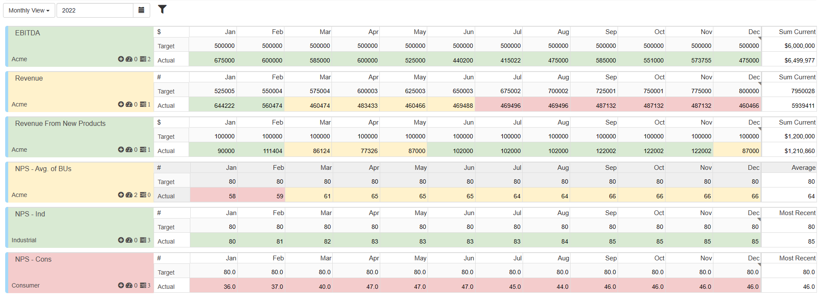
Metric Bowling View
View Metric Performance RYG and Edit Actuals for Multiple Metrics

Slide 21
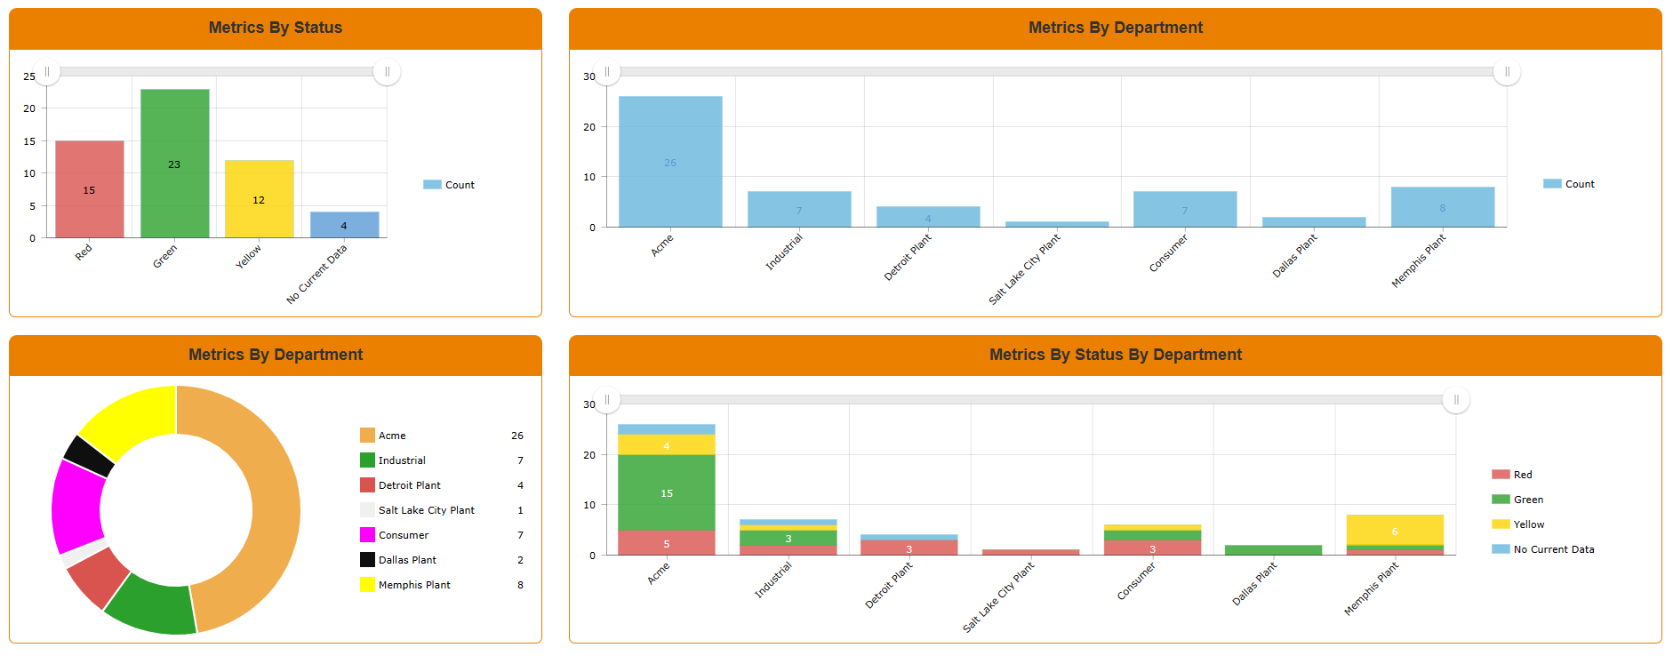
Metric Summary Report

Slide 22
Idea Reports
Idea Funnel / Prioritization
Team Engagement Report

Slide 23
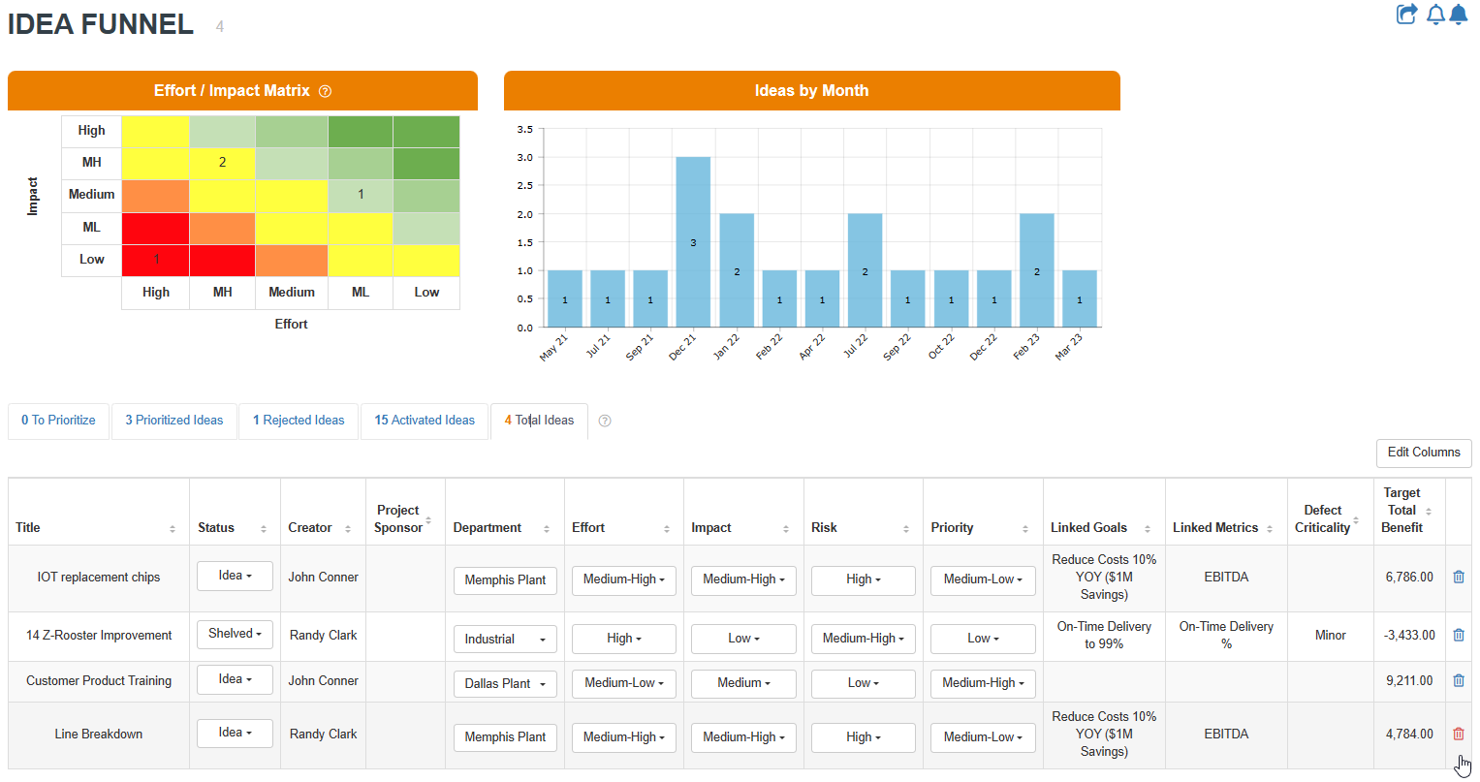
Idea Funnel / Prioritization
Effort / Impact Matrix
Score Based on Effort / Impact / Risk
Visualize Ideas in the Green “Go Zone”

Slide 24
Team Engagement Report
Who is Submitting Ideas

Slide 25
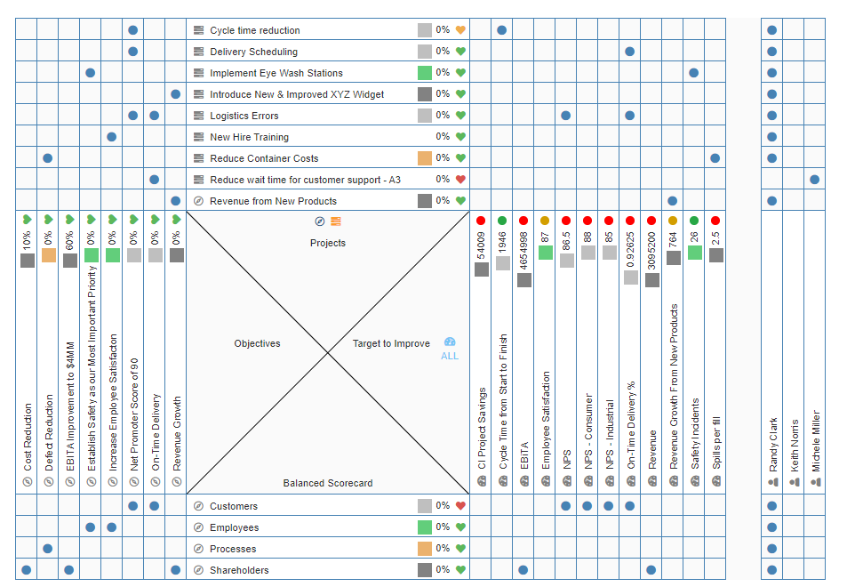
Goal Reports
List View
Tile View
Bowling View
Grid View
X-Matrix View

Slide 26
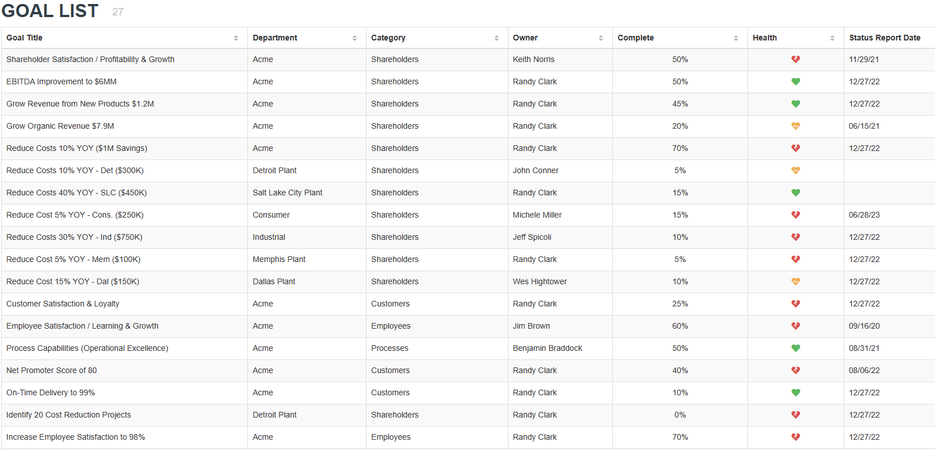
Goal List View

Slide 27
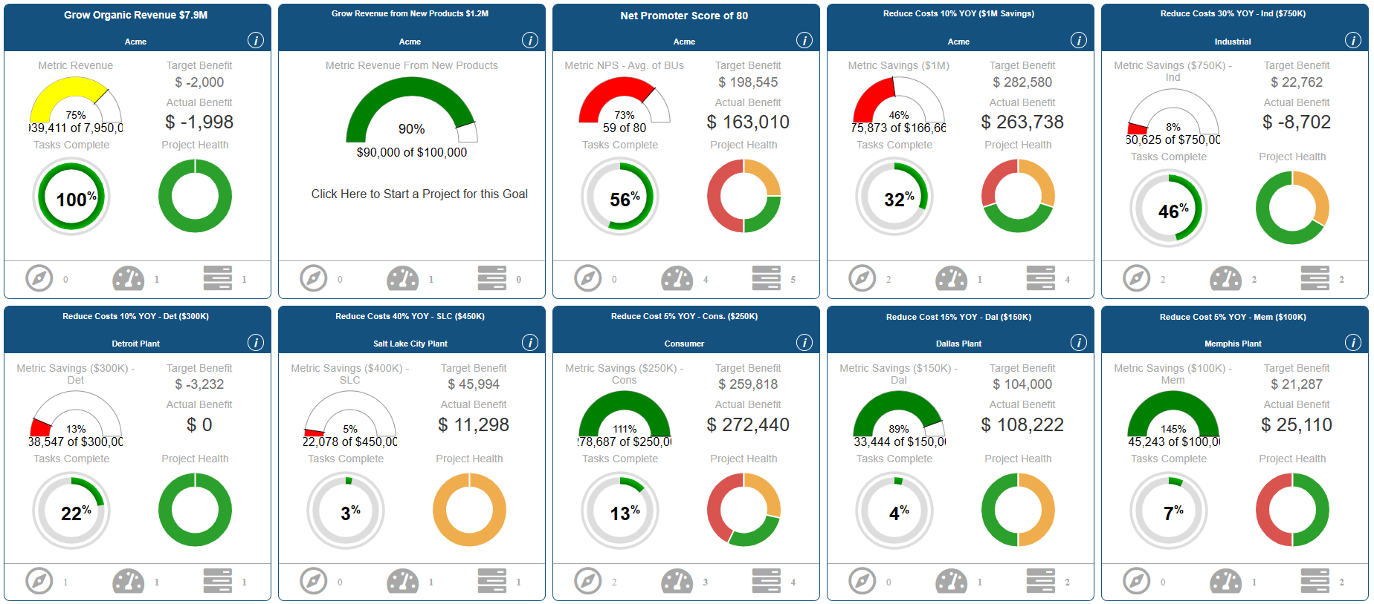
Goal Tile View

Slide 28
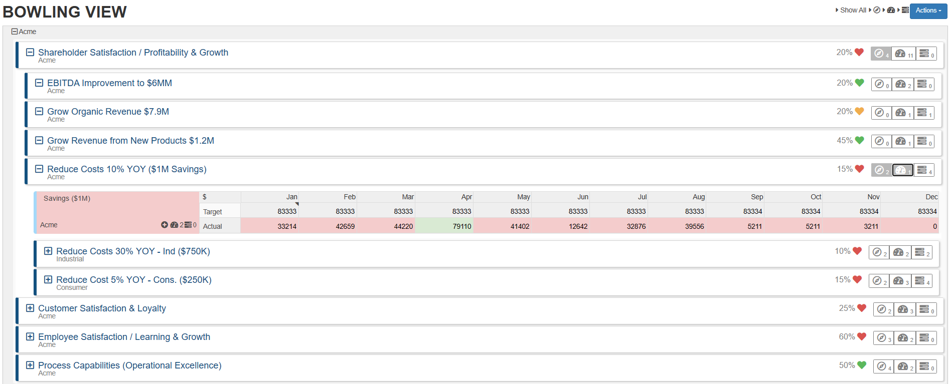
Goal Bowling View

Slide 29
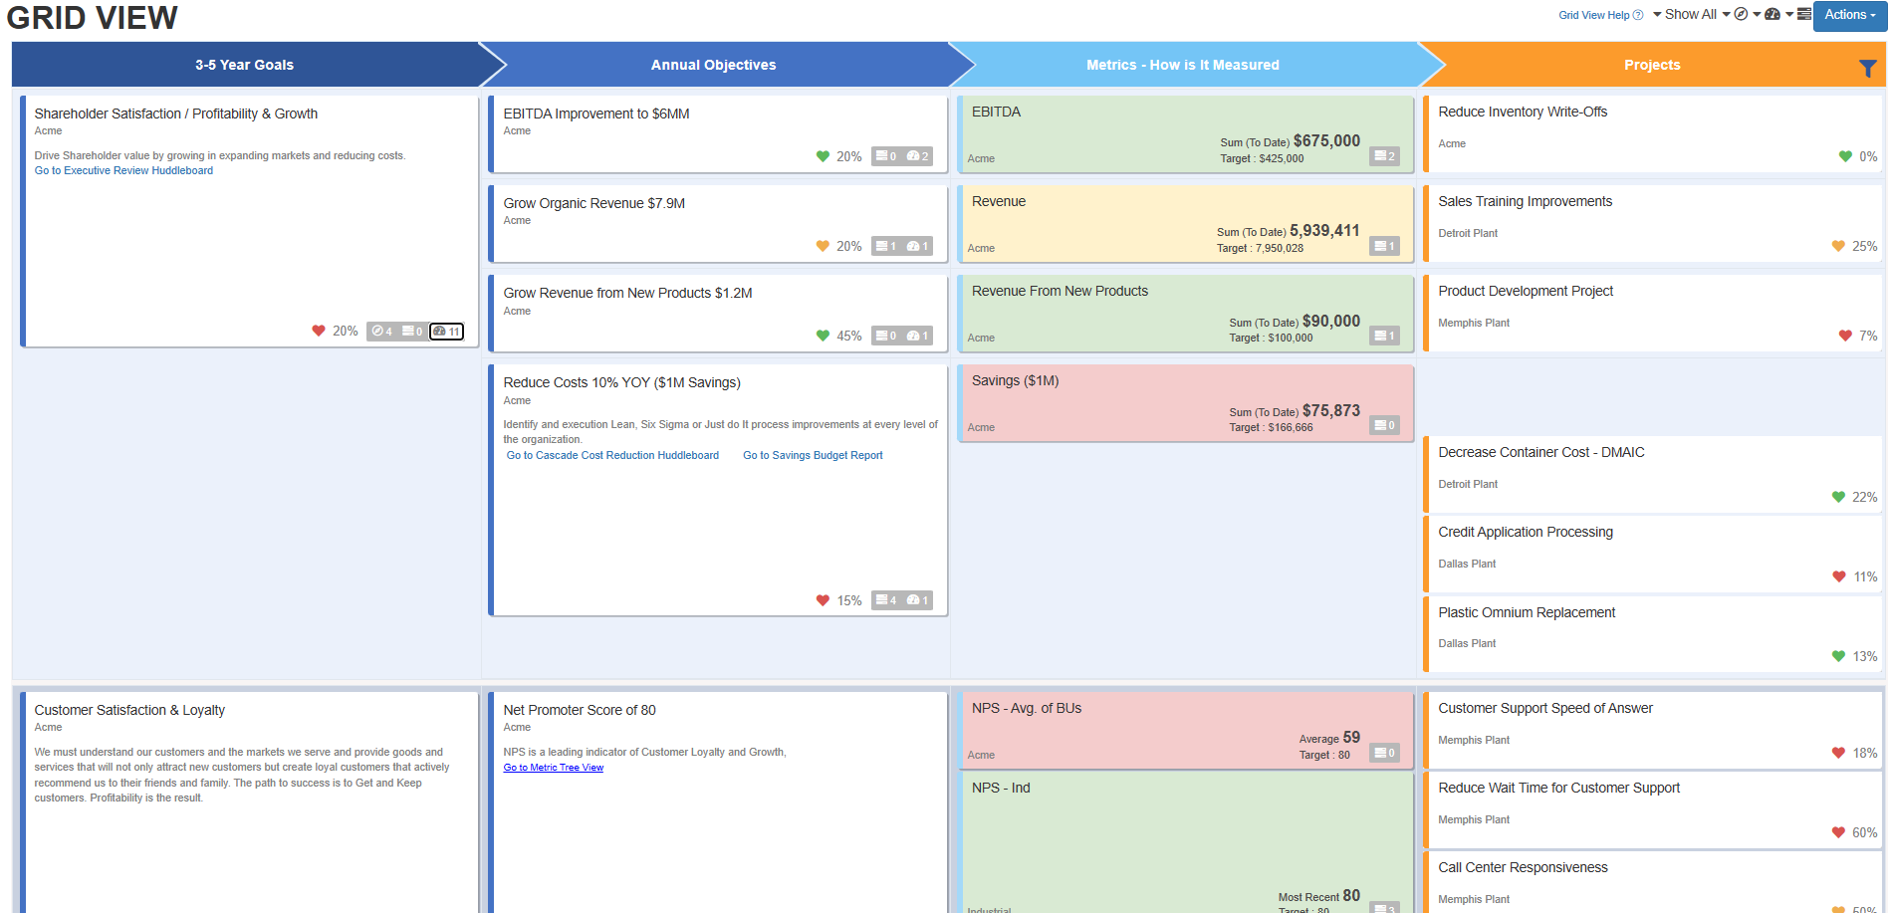
Goal Grid View

Slide 30
X-Matrix View

Slide 31
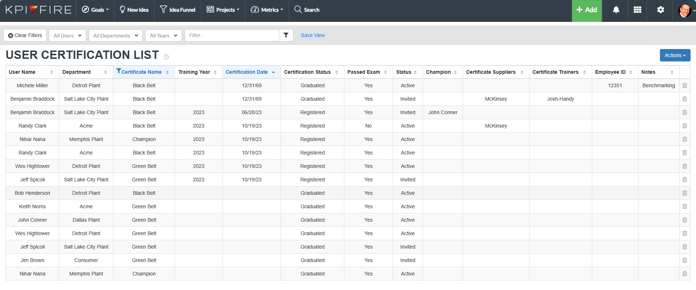
User Reports
User Certification List View

Slide 32
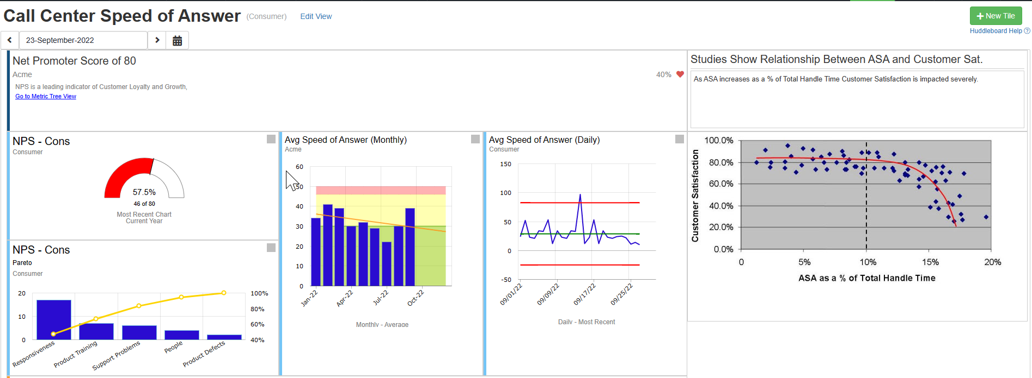
Huddleboards
Build your Own Custom Dashboard Reports
Custom X-Matrix
Balanced Scorecard

Slide 33
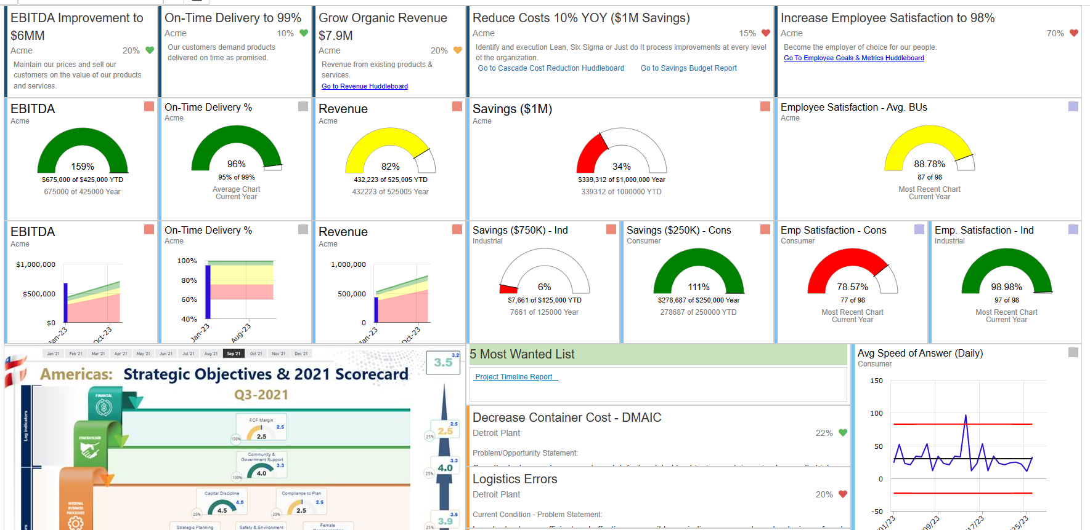
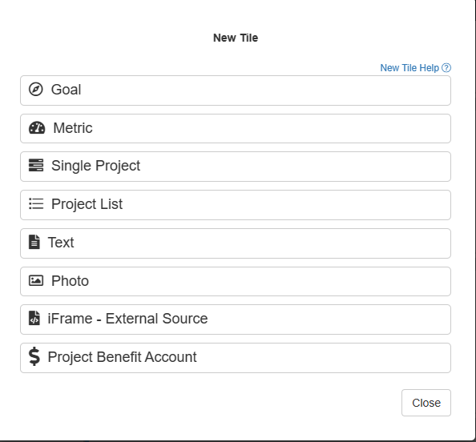
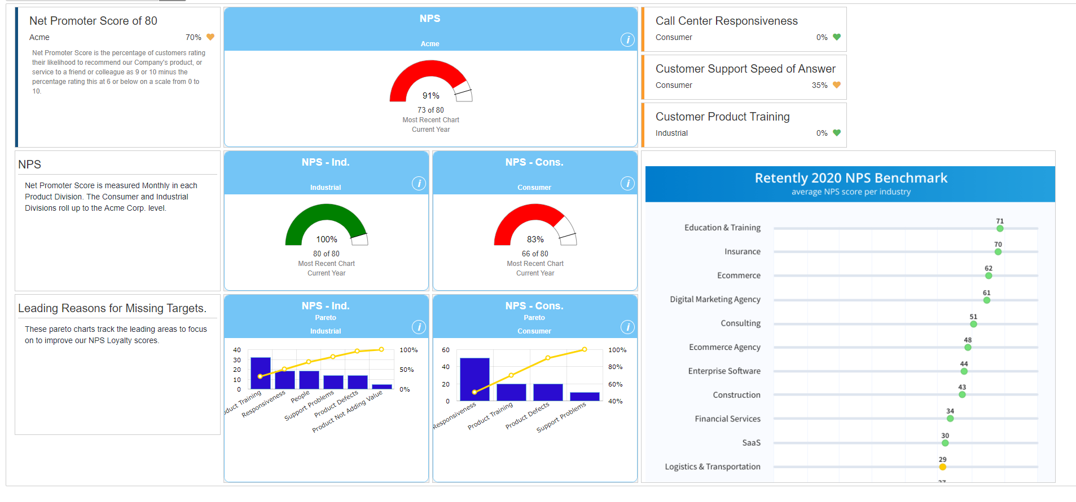
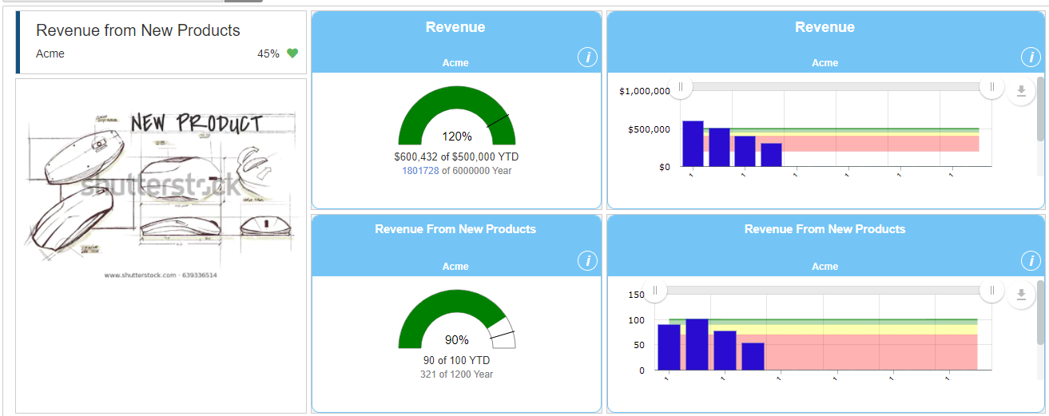
Huddleboard Examples
Create your own Dashboards

Slide 34
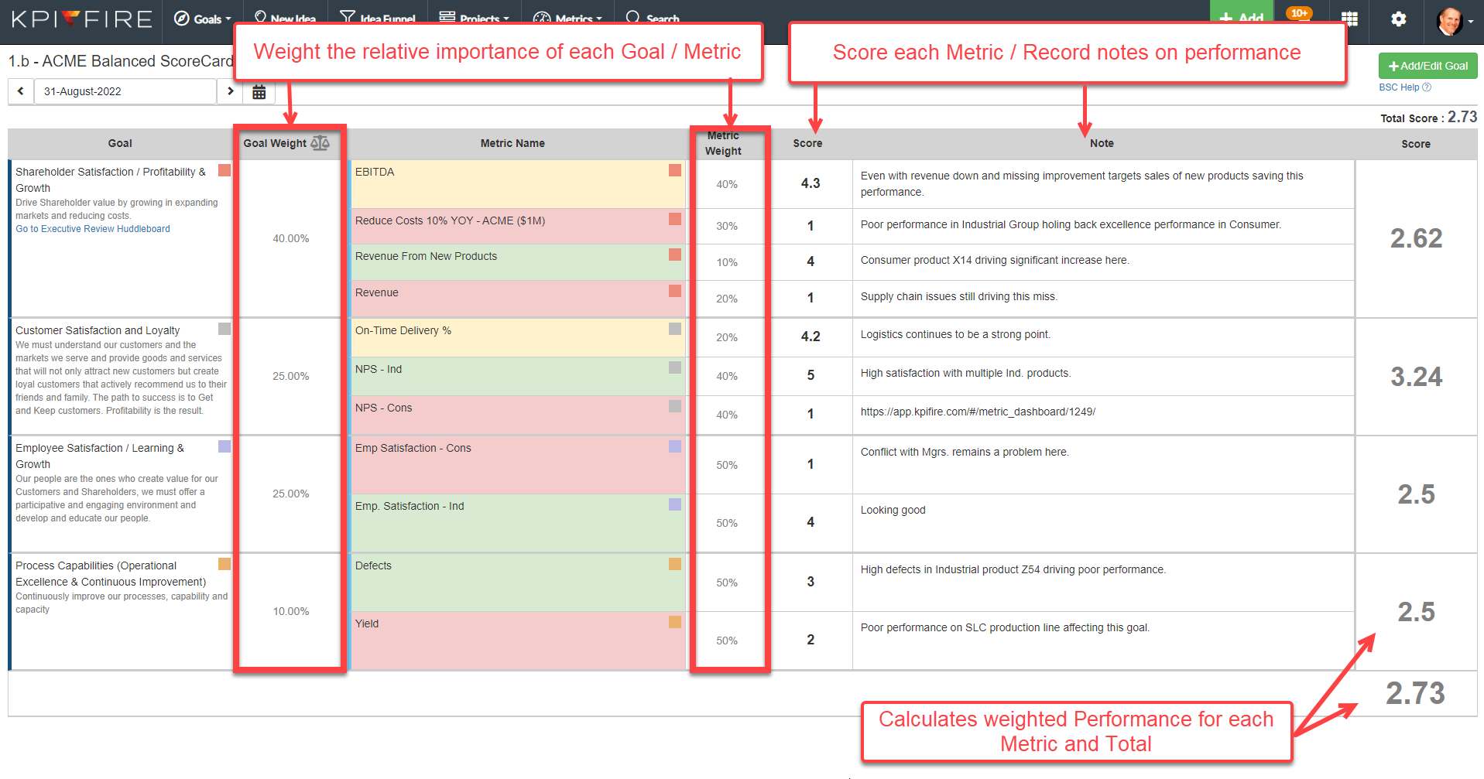
Dashboard
Balanced ScoreCard

Slide 35
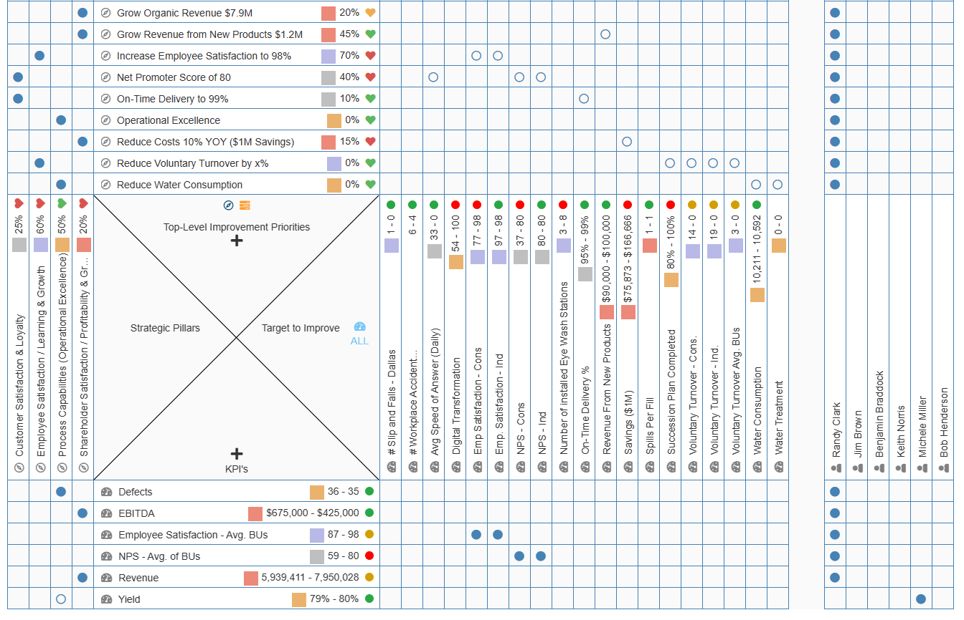
Custom X-Matrix
Flexible X-Matrix
Modify what Data is Displayed on each Axis

Slide 36
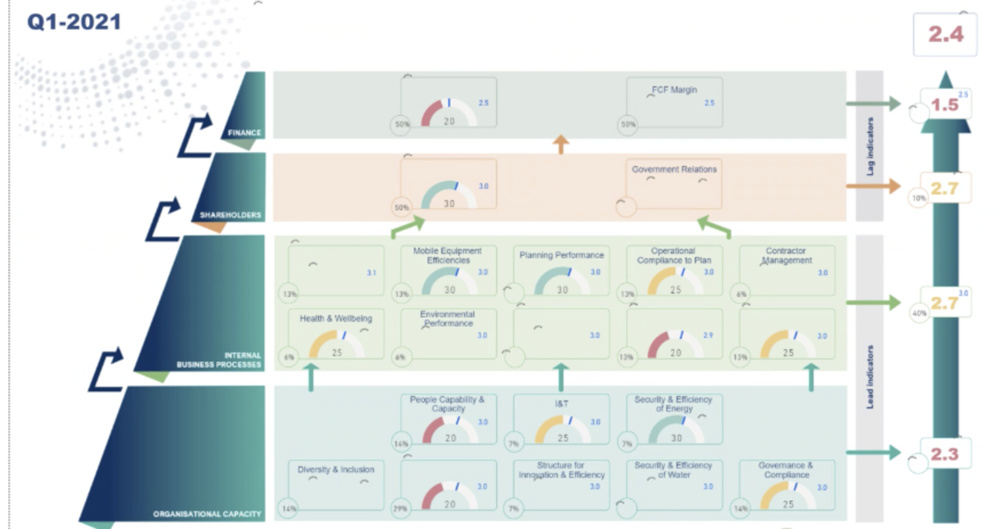
PowerBI Reporting - Customer Example
Export your Data, or use our API’s to Feed PowerBI

Slide 37
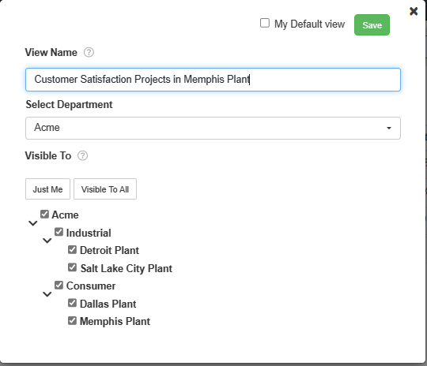
Filter by Goal / Department
Filter Bar Example
List all Projects Linked to Customer Related Goals
In the Memphis Plant
Save the View for Quick Access

Slide 38
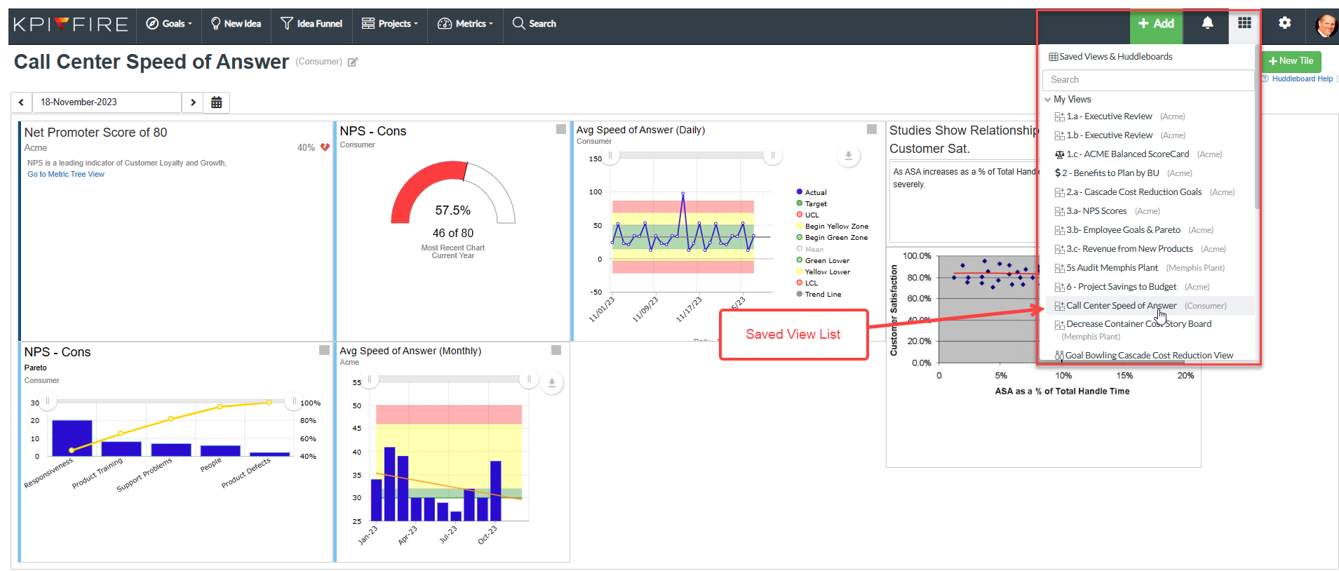
Easy Access to Saved Views

Slide 39
Ready to Ignite Your Strategy?
Randy Clark
(801) 456-8172
Randy.Clark@kpifire.com
kpifire.com

